Slide 1
Enhancing SPR sensor Sensitivity
By:
Arush Shetty (2021A3PS2661P)
Under
Dr. Pankaj Arora
Assistant Professor
EEE Dept., BITS-Pilani

Slide 2
Contents
1.Finding the most optimum STO thickness
2.Effect of various 2-D nanomaterials on SPR attributes and selection of best 2d nanomaterial out of all.
3.Simulating for different metals (Ag,Au,Al).
4.The final proposed device.

Slide 3
Optimizing STO thickness
To optimize Strontium Titanate(STO) layer thickness we ran tests in which we varied the thickness of STO from 2nm to 20nm which was then stacked with a single layer of graphene.
We finally concluded 7nm to be the most optimum thickness
Analyte
graphene
STO
metal
prism

Slide 4
Effect of various 2-D nanomaterials on SPR attributes
In The following section the given 2D nanomaterials were stacked on top of the STO layer (7 nm):
1.MoS2
2.MXene
3.Antimony(Sb)
4.Graphene(Gr)
5.Black Phosphorus
6.Fluorinated Graphene

Slide 5
Characteristics of MoS2
No of layers | Sensitivity | FOM | Rmin | FWHM
2 | 174 | 790.9 | 0.00058 | 0.22
3 | 174.5 | 793.18 | 0.000463 | 0.22
4 | 175 | 795.4545 | 0.00047194 | 0.22
5 | 175.5 | 797.7273 | 0.00056688 | 0.22
6 | 176 | 800 | 0.00071234 | 0.22
7 | 177 | 804.5455 | 0.00079955 | 0.22
8 | 177.5 | 806.8182 | 0.00058137 | 0.22
9 | 178.5 | 811.3636 | 0.00042321 | 0.22
10 | 179 | 813.6364 | 0.00030841 | 0.22
11 | 179.5 | 815.9091 | 0.00022464 | 0.22
12 | 180 | 818.1818 | 0.00016298 | 0.22
13 | 181 | 822.7273 | 0.00011717 | 0.22
14 | 181.5 | 806.6667 | 8.2887e-05 | 0.225

Slide 6
MoS2 (Continued)
No of layers | Sensitivity | FOM | Rmin | FWHM
15 | 182 | 791.3043 | 5.7256e-05 | 0.23
16 | 183 | 795.6522 | 3.8349e-05 | 0.23
17 | 183.5 | 797.8261 | 2.4876e-05 | 0.23
18 | 184 | 800 | 1.5956e-05 | 0.23
19 | 185 | 804.3478 | 1.1015e-05 | 0.23
20 | 185.5 | 806.5217 | 9.7932e-06 | 0.23

Slide 7
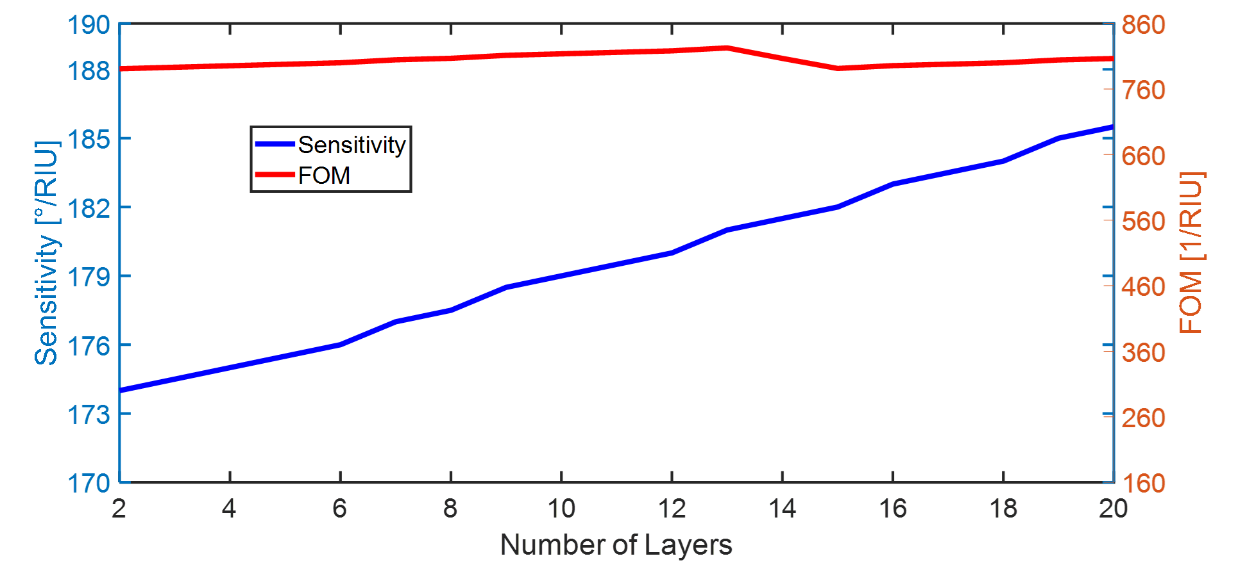
Sensitivity & FOM v/s no. of layers – MoS2

Slide 8
Characteristics of MXene
No of layers | Sensitivity | FOM | Rmin | FWHM
2 | 174 | 570.4918 | 0.092896 | 0.305
3 | 175 | 500 | 0.15326 | 0.35
4 | 175.5 | 444.3038 | 0.21038 | 0.395
5 | 176.5 | 401.1364 | 0.26224 | 0.44
6 | 177.5 | 362.2449 | 0.30885 | 0.49
7 | 178.5 | 333.6449 | 0.35054 | 0.535
8 | 179 | 308.6207 | 0.38781 | 0.58
9 | 180 | 285.7143 | 0.42122 | 0.63
10 | 180.5 | 265.4412 | 0.45126 | 0.68
11 | 182 | 251.034 | 0.47835 | 0.725
12 | 182.5 | 235.4839 | 0.50288 | 0.775
13 | 183.5 | 222.4242 | 0.52522 | 0.825
14 | 184.5 | 212.069 | 0.54557 | 0.87

Slide 9
MXene (Continued)
No of layers | Sensitivity | FOM | Rmin | FWHM
15 | 185.5 | 201.6304 | 0.56424 | 0.92
16 | 186 | 191.7526 | 0.58137 | 0.97
17 | 187 | 182.439 | 0.59717 | 1.025
18 | 187.5 | 175.2336 | 0.61177 | 1.07
19 | 188.5 | 168.3036 | 0.62532 | 1.12
20 | 189.5 | 161.9658 | 0.63791 | 1.17

Slide 10
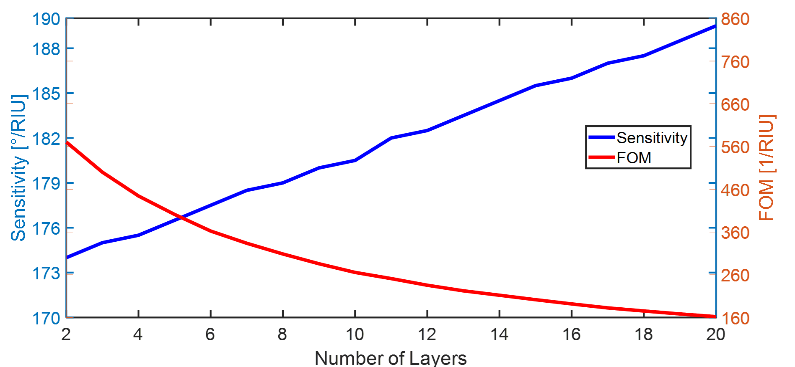
Sensitivity & FOM v/s no. of layers – MXene

Slide 11
Characteristics of Antimony(Sb)
No of layers | Sensitivity | FOM | Rmin | FWHM
2 | 173 | 804.6512 | 0.00091206 | 0.215
3 | 173.5 | 806.9767 | 0.00087257 | 0.215
4 | 174 | 809.3023 | 0.00085887 | 0.215
5 | 174 | 809.3023 | 0.00087497 | 0.215
6 | 174.5 | 811.6279 | 0.0009277 | 0.215
7 | 175.5 | 816.2791 | 0.00090791 | 0.215
8 | 175.5 | 797.7273 | 0.0007207 | 0.22
9 | 176 | 800 | 0.0005348 | 0.22
10 | 176.5 | 820.9302 | 0.00036988 | 0.215
11 | 176.5 | 820.9302 | 0.00025084 | 0.215
12 | 177 | 823.255 | 0.00020822 | 0.215
13 | 177.5 | 825.5814 | 0.00027868 | 0.215
14 | 177.5 | 825.5814 | 0.00050536 | 0.215

Slide 12
Sb (Continued)
No of layers | Sensitivity | FOM | Rmin | FWHM
15 | 178.5 | 850 | 0.00059186 | 0.21
16 | 178.5 | 830.2326 | 0.00022611 | 0.215
17 | 179 | 832.5581 | 9.3294e-05 | 0.215
18 | 179 | 832.5581 | 0.00026652 | 0.215
19 | 180 | 857.1429 | 0.00057034 | 0.21
20 | 180 | 857.1429 | 0.0001026 | 0.21

Slide 13
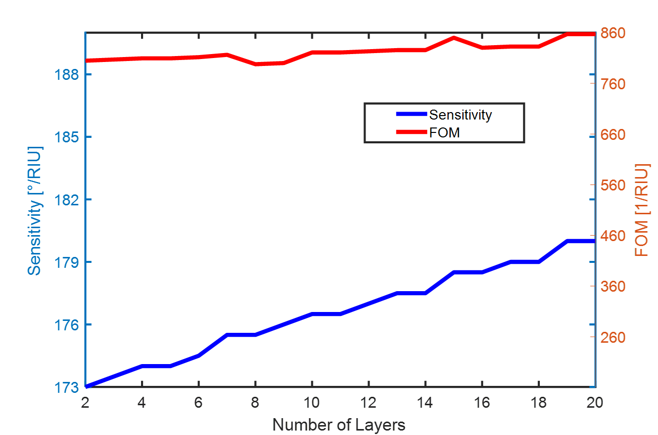
Sensitivity & FOM v/s no. of layers – Sb

Slide 14
Characteristics of Graphene
No of layers | Sensitivity | FWHM | FOM | Rmin
2 | 173 | 0.24 | 720.8333 | 0.017364
3 | 173.5 | 0.255 | 680.3922 | 0.031512
4 | 174 | 0.27 | 644.44 | 0.048132
5 | 174.5 | 0.285 | 612.28 | 0.066437
6 | 174.5 | 0.3 | 581.667 | 0.085641
7 | 174.5 | 0.315 | 553.968 | 0.10539
8 | 175 | 0.33 | 530.303 | 0.12555
9 | 175.5 | 0.345 | 508.6957 | 0.14584
10 | 176 | 0.355 | 495.774 | 0.16608

Slide 15
Graphene(Continued)
No of layers | Sensitivity | FWHM | FOM | Rmin
11 | 176.5 | 0.37 | 477.027 | 0.18612
12 | 176.5 | 0.385 | 458.4416 | 0.20586
13 | 176.5 | 0.405 | 435.8025 | 0.22521
14 | 177 | 0.42 | 421.4286 | 0.24404
15 | 177.5 | 0.44 | 403.4091 | 0.2642
16 | 177.5 | 0.455 | 390.1099 | 0.28033
17 | 178 | 0.475 | 374.7368 | 0.29775
18 | 178.5 | 0.49 | 364.2857 | 0.31467
19 | 179 | 0.505 | 354.4554 | 0.33109
20 | 179 | 0.525 | 340.9524 | 0.347

Slide 16
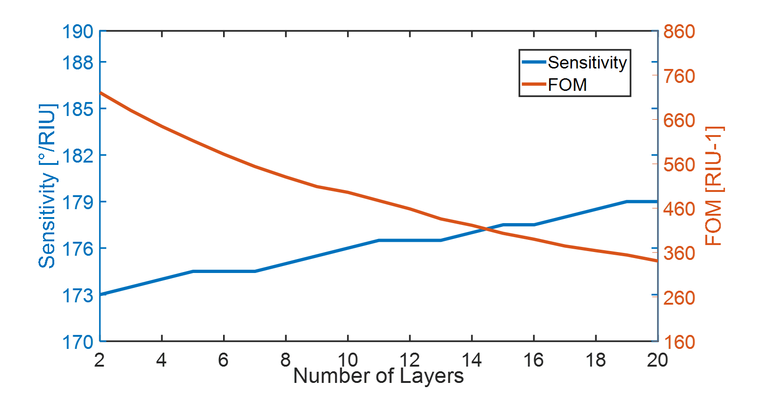
Sensitivity & FOM v/s no. of layers – Graphene

Slide 17
Characteristics of Black Phosphorus
No of layers | Sensitivity | FWHM | FOM | Rmin
2 | 173.5 | 0.25 | 694 | 0.024
3 | 174 | 0.265 | 656.6038 | 0.043
4 | 174.5 | 0.285 | 612.2807 | 0.064963
5 | 175 | 0.305 | 573.7706 | 0.0883
6 | 175.5 | 0.32 | 548.4375 | 0.11256
7 | 176 | 0.34 | 517.6471 | 0.13701
8 | 176.5 | 0.36 | 490.2778 | 0.16135
9 | 177 | 0.38 | 465.7891 | 0.18534
10 | 177.5 | 0.4 | 443.75 | 0.2088

Slide 18
Black Phosphorus (Continued)
No of layers | Sensitivity | FWHM | FOM | Rmin
11 | 178 | 0.42 | 423.8095 | 0.23162
12 | 178.5 | 0.44 | 405.6818 | 0.25375
13 | 179 | 0.465 | 384.9462 | 0.27513
14 | 180 | 0.485 | 371.134 | 0.29575
15 | 180.5 | 0.51 | 353.9216 | 0.31555
16 | 181 | 0.525 | 344.7619 | 0.3341
17 | 181 | 0.55 | 329.0909 | 0.35295
18 | 181.5 | 0.575 | 315.6522 | 0.37058
19 | 182 | 0.6 | 303.333 | 0.38753
20 | 183 | 0.62 | 295.1613 | 0.40382

Slide 19
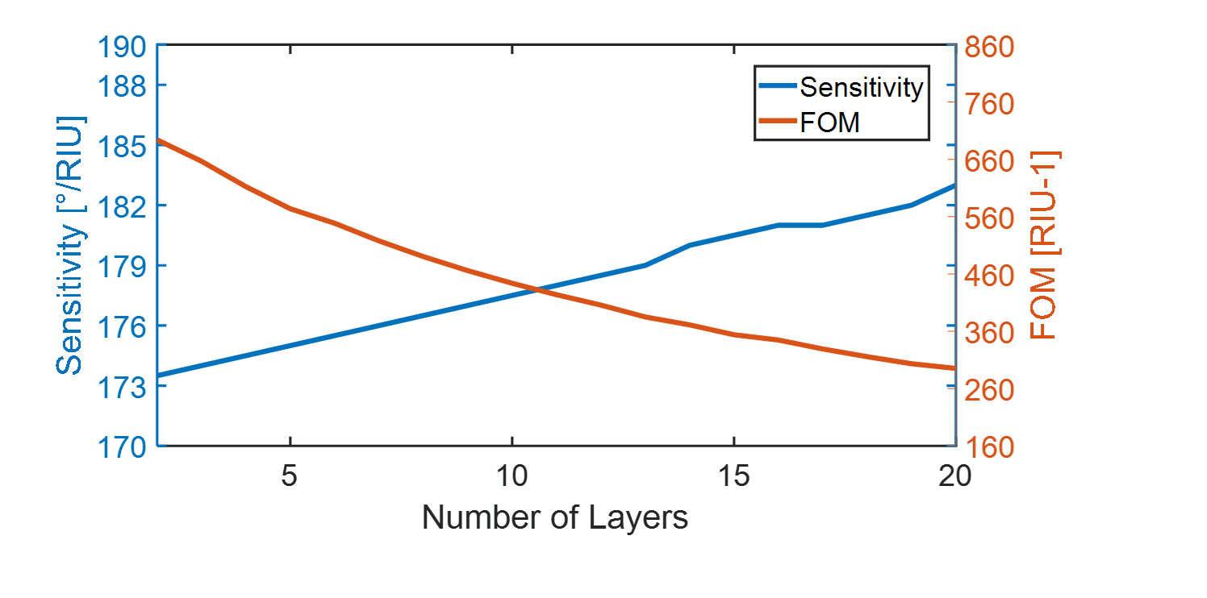
Sensitivity & FOM v/s no. of layers – Black Phosphorus

Slide 20
Characteristics of Fluorinated Graphene
No of layers | Sensitivity | FWHM | FOM | Rmin
2 | 173 | 0.215 | 804.65 | 0.000603
3 | 173.5 | 0.22 | 788.63 | 0.000802
4 | 173.5 | 0.215 | 806.97 | 0.0001
5 | 174 | 0.215 | 809.30 | 0.0006
6 | 174 | 0.215 | 809.3023 | 0.00048
7 | 174.5 | 0.22 | 793.181 | 0.00064
8 | 174.5 | 0.22 | 793.1818 | 0.00099
9 | 175 | 0.215 | 813.9535 | 0.00056
10 | 175 | 0.215 | 813.9535 | 0.0003

Slide 21
Fluorinated Graphene (Continued)
No of layers | Sensitivity | FWHM | FOM | Rmin
11 | 175.5 | 0.22 | 797.72 | 0.00048
12 | 176 | 0.22 | 800 | 0.00084
13 | 176 | 0.215 | 818.6047 | 0.000567
14 | 176 | 0.215 | 818.6047 | 0.00035
15 | 176.5 | 0.22 | 802.2727 | 0.00033
16 | 177 | 0.22 | 804.54 | 0.000576
17 | 177 | 0.215 | 823.2558 | 0.000673
18 | 177 | 0.215 | 823.2558 | 0.000331
19 | 177.5 | 0.215 | 825.58 | 0.000214
20 | 178 | 0.22 | 809.0909 | 0.00031764

Slide 22
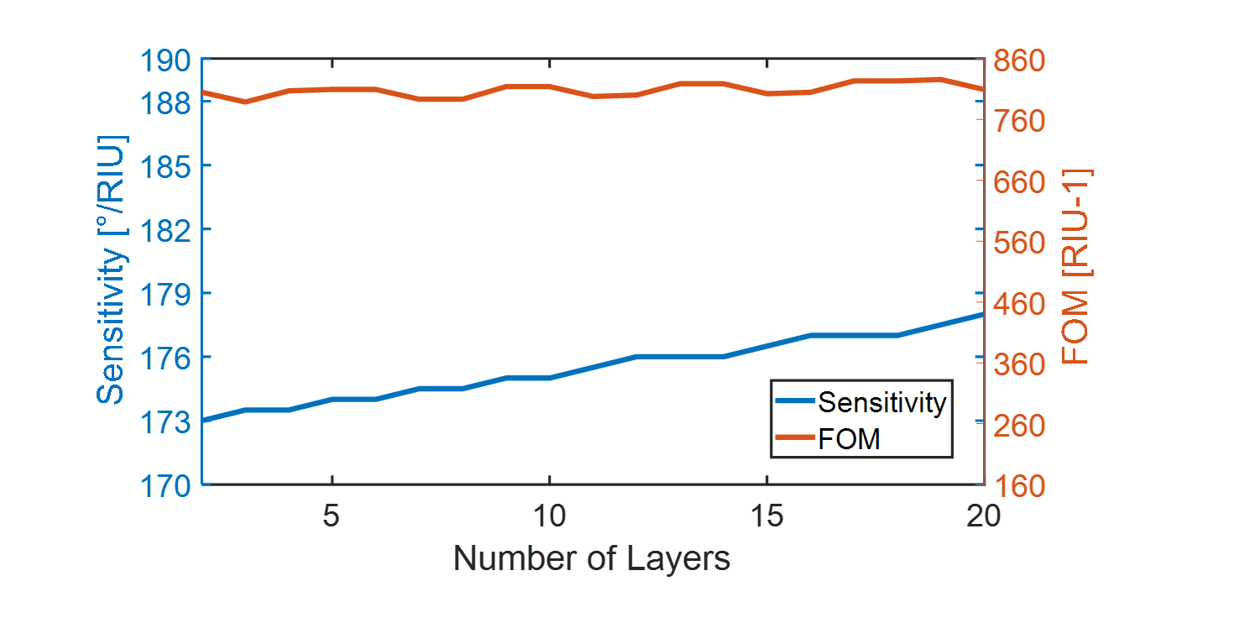
Sensitivity & FOM v/s no. of layers – Fluorinated Graphene

Slide 23
Finalizing the 2-D Nanomaterial
After running the simulations we observe almost constant values of sensitivity and FOM with varying number of layers for Sb.
Therefore, we conclude that Antimony (Sb) is the most suitable nanomaterial for our purpose.

Slide 24
Gold/Silver/Aluminium as the metal layer
In this section we attempt to find the optimum thickness of each metal (Au and Ag) and compare it with Al.
The optimum thickness of aluminum is considered as 30nm.

Slide 25
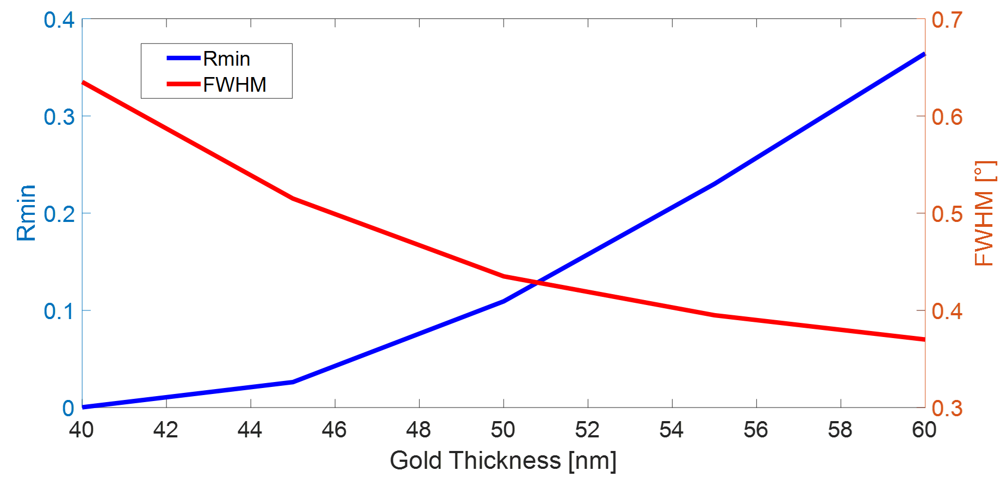
Plot of FWHM and Rmin against Thickness for Gold
Optimum Thickness comes out to be 50.8nm

Slide 26
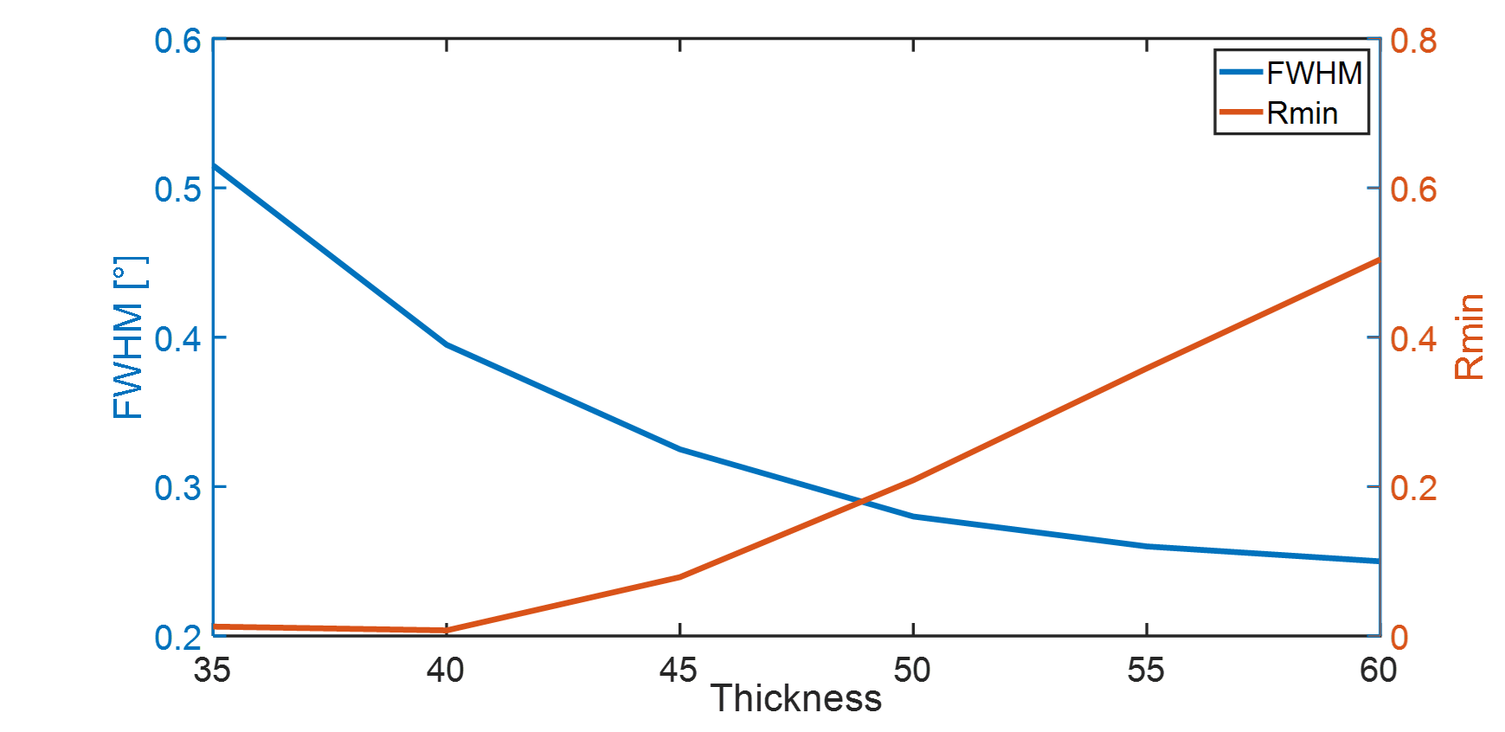
Plot of FWHM and Rmin against Thickness for Silver
Optimum Thickness comes out to be 48.8nm

Slide 27
Parameters for optimum length
 | Gold (50.8 nm) | Silver (48.8 nm) | Aluminum (30 nm)
Sensitivity | 181 | 178.5 | 172.5
Rmin | 0.12672 | 0.17248 | 0.00097571
FOM | 425.8824 | 615.5172 | 802.3256
FWHM | 0.425 | 0.29 | 0.215
Optimum thickness for these metals are found out by seeing the intersection point of FWHM and Rmin plotted against Thickness. In case of gold comes out to be 50.8nm, for Silver it is 48.8nm and for aluminum it is 30nm.

Slide 28
Conclusion - Final proposed device
The most optimal configuration to achieve maximum sensitivity and desirable outcomes comes out to be
Aluminium as the metal layer : 30 nm
STO (SrTiO3) as interlayer : 7nm
Antimony(Sb) as 2d nanomaterial : 1layer(1nm)
Analyte
Sb(1nm)
STO(7nm)
Al(30 nm)
Prism

